Slide 1
EXERCISE 5
The Ru-106 event in autumn 2017
Aims:
Work with a complex real case scenario with an unknown source
Understand the Probable Source Regions (PSR)
Poor man’s inversion
Questions? Write christian.maurer@zamg.ac.at
Notes:
1
1

Slide 2
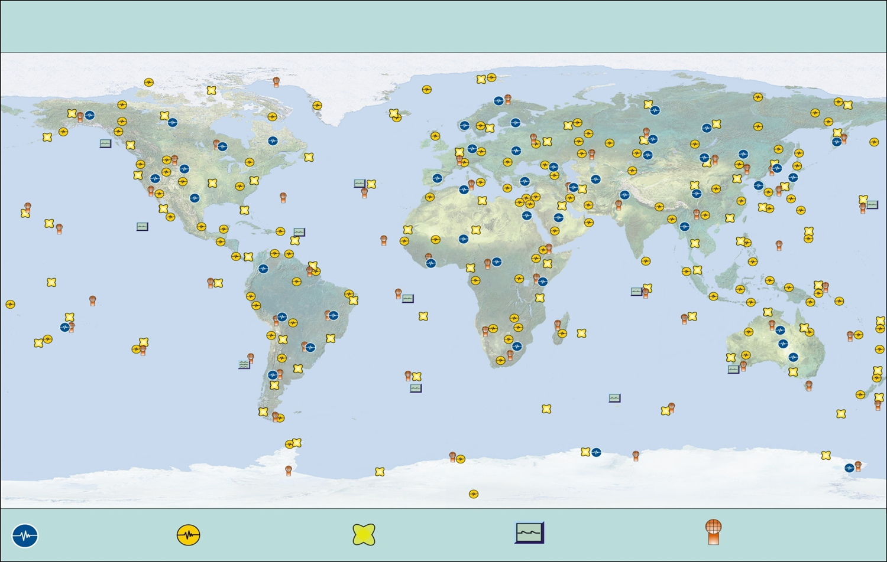
Comprehensive Nuclear Test-Ban Treaty (CTBT)
ARTICLE I - BASIC OBLIGATIONS
Each State Party undertakes not to carry out any nuclear weapon test explosion or any other nuclear explosion, and to prohibit and prevent any such nuclear explosion at any place under its jurisdiction or control.
Entry into force: As soon as 44 countries which operate nuclear reactors have ratified the Treaty (not just signed).
The International Monitoring System (IMS)
80 radionuclide
stations foreseen, whereof 40 will be equipped with noble gas measuring devices
>80 % of the network currently installed
Primary seismic
stations
Auxiliary seismic
stations
Radionuclide
stations
Hydroacustic
stations
Infrasound
stations

Slide 3
Ru-106 real scenario: Set-up the FLEXPART run
Specifications:
COMMAND FILE:
Backward run: 25 September 2017 00 UTC to 3 October 2017 09 UTC
Output every 3 hours
Convection
Residence times output
No nested output
No adaptation to TL
OUTGRID FILE:
Resolution 1.0 degree
LLC: 0.0°N, -179.0°E
90x360 grid cells
1 output layer, 150 m a.g.l.
RELEASES FILE:
Point source at CTBTO IMS station Stockholm (SEP63): 59.41°N, 17.95°E, 0-10 m a.g.l.
1st release:
Release start: 30 September 2017, 09 UTC
Release end: 1 October 2017, 09 UTC
Total mass: 1 Bq of Ru-106 (species nr. 18)
Particles released: 100000
COMMENT = "RELEASE_SEP63_1
2nd and 3rd release:
Release start: 1 and 2 October 2017, 09 UTC
Release end 2 and 3 October 2017, 09 UTC
Total mass, particles released and appropriate comments as for 1st release
Which of the first two samples (release ends on 1 and 2 October) could be related to the nuclear facilities of Dimitrovgrad or Majak in Russia at around Sep., 25th, 21 UTC, to 26th, 03 UTC ?

Slide 4
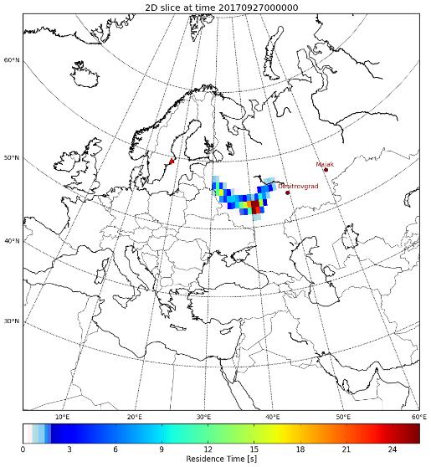
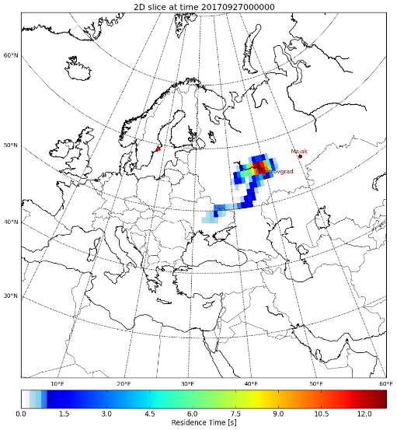
Ru-106 real scenario: Source term estimate
Assuming a release between Sep., 26th, 00 UTC, and 03 UTC, and a measurement of 1 mBq/m3 at SEP63 between 1 Oct., 9 UTC, and 2 Oct., 9 UTC, what is your source term estimate?
„Poor man‘s inversion“
m[Bq/m³] = M[s] * s[Bq/s*m³] S[Bq]=m[Bq/m³]/M[s]*3*3600[s]*100000*100000*150[m³]
m = measurement
M = transfer coeffcient matrix (aka source receptor sensitivity, footprint ...)
S = source
Release 1
Release 2
ECMWF:
./plot_FLEX_binary.py ./output_ECMWF[NCEP]/ False nuc1 0 0 [1] alldates lcc False 0,65,30,75 mesh True

Slide 5
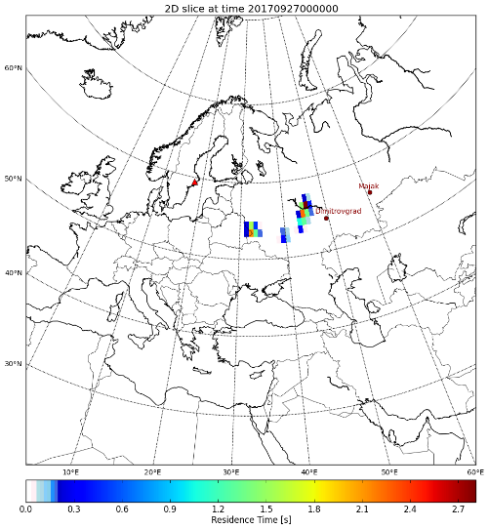
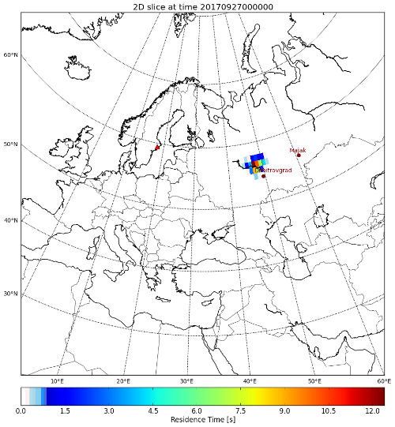
Ru-106 real scenario: Source term estimate
m[Bq/m³] = M[s] * s[Bq/s*m³] s[Bq]=m[Bq/m³]/M[s]*3*3600[s]*100000*100000*150[m³]
ECMWF:
Release 1
Release 2
NCEP:
Release 1
Release 2

Slide 6
Ru-106 real scenario: The concept of SRS fields
SRS file: An ASCII file consisting of a header line with all the metadata information and four columns afterward with the loaction and time of non-zero FLEXPART concentrations for just one vertical level:
17.950 59.410 20170930 09 20171001 09 0.10E+01 153 3 3 1.000 1.000 "Ru-106" -179.0000 0.0000 360 90
58.000 17.000 1 0.2222537E-05
Source location longitude
Source location latitude
Collection start time
Collection stop time
Released mass
Output simulation time length
Output time interval
Output time interval (place holder)
Horizontal resolution in longitude direction (degrees)
Horizontal resolution in latitude direction (degrees)
Species Name
Lower left corner longitude of OUTGRID in degrees
Lower left corner latitude of OUTGRID in degrees
Number of grid cells in longitude direction
Number of grid cells in latitude direction
58.000 17.000 1 0.2222537E-05
59.000 17.000 1 0.1206449E+03
58.000 18.000 1 0.1381382E+02
.
.
Lower left corner latitude of respective grid box
Lower lef corner longitude of respective grid box
Time step (positive if bwd)
Non-zero concentration
What is an srs file, where do they come from, why useful... Why do we do this?????
What is a psr, what is useful for?.... Maybe a definitions slide?
Very intiutive way of depicting FLEXPART output for one level and all time steps, standard FLEXPART output format of CTBTO

Slide 7
Ru-106 real scenario: The concept of PSR fields
For every grid cell and time step: Determine how well measurements fit a release. Assumption of ~ puff release. Also „non-detections“ can be helpful for constraining the source region.
Measurements
SRS values
-99.90 -99.90 20171003 09 20171003 09 0.10E+01 201 3 3 1.00 1.00 -179.0 0.0 360 89 "CORRELATION MAP“
Header very similar to that of SRS files. However, no station coordinates are given as there could be much more than just one station involved.
1
17.95 59.41
Number and coordinates of all involved sampling stations (blue stars in figure above)
51.00 14.00 16 0.6077475E-08 0.3692852E-08 0.4999775E-03
Lower left corner latitude of respective grid box, lower left corner longitude of respective grid box, time step, explained variance (R²), slope of regression and offset of regression

Slide 8
Ru-106 real scenario: Create srs files
Create ASCII-srs files (one level, all time steps) from binary FLEXPART output (one time step, all levels):
ln -s /exercise_material_ru106/flexout2srsmnetcdf.out
mkdir outputsrs_ECMWF[NCEP], outputsrs_ECMWF[NCEP]/20171001/, outputsrs_ECMWF[NCEP]/20171002/ and outputsrs_ECMWF[NCEP]/20171003/
Create CONTROL file:
./output_ECMWF[NCEP]/
./summed_binary/ ! path for summed binary - NOT needed for current application
==================================
1 ! Number of FLEXPART level to start at
1 ! Number of FLEXPART level to stop at
1.0 ! Multiplication factor to get s
fp ! Model name stamp in file name
f10 ! Version stamp in file name
1 ! species to start with
1 ! species to end with
1 [2,3] ! selected release - VERY IMPORTANT for current application
1900010100 ! selected start date-time
2100010100 ! selected stop date-time
.false. ! indication, whether summed binary should be produced
001 ! file suffix for summed binary - NOT needed for current application
part-sum ! summed species name for summed binary - NOT needed for current application
.false. ! indication, whether simple file name should be used
.false. ! indication, whether decay should be applied a posteriori
./flexout2srsmnetcdf.out
Gzip and move conc_RELEASE_SEP63_1_Ru-106.fp.2017100109.f10.1.srm, conc_RELEASE_SEP63_2_Ru-106.fp.2017100209.f10.1.srm and conc_RELEASE_SEP63_3_Ru-106.fp.2017100309.f10.1.srm to outputsrs_ECMWF[NCEP]/20171001/, outputsrs_ECMWF[NCEP]/20171002/ and outputsrs_ECMWF[NCEP]/20171003/

Slide 9
Ru-106 real scenario: Create PRS fields
Create Probable Source Region (PSR) fields:
ln -s /exercise_material_ru106/locate_multi
Create CONTROL file:
# SRS File archive
./outputsrs_ECMWF[NCEP]/
#
# Species measured
#
1 ! number of species
Ru-106 0.0 ! half-life [s]
#
# Scenario/Measurements
#
1E-18 ! background concentration, used only for FOI approach
3 ! number of measurements
conc_RELEASE_SEP63 20171001 09 0.0E-3 ! station | collection stop | concentration above MDC
conc_RELEASE_SEP63 20171002 09 1.0E-3
conc_RELEASE_SEP63 20171003 09 0.5E-3
FALSE ! indication, whether srs-files are in CTBTO format (corner longitudes and latitudes of global field not given)
FALSE ! indication, whether time integration should be applied
10.75 ! days to start time integration before last collection stop
++++++++++++++++++++++++++++
./locate_multi: yields output correlation.txt (Please ignore the source estimate given by locate_multi in the last but one line of the screen output! Using this information requires a non-standard FLEXPART output in bwd mode!).
Assume consecutive samples of 0, 1 and 0.5 mBq/m3 (1 mBq/m3 = 1E-3 Bq/m3)

Slide 10
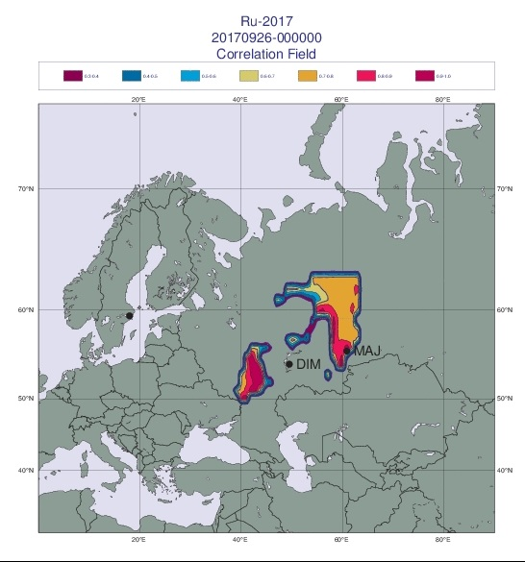
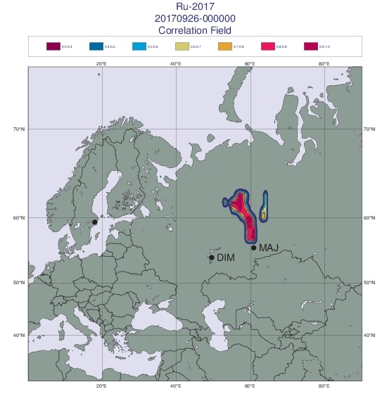
Ru-106 real scenario: Plot PRS fields
Plot PSR fields:
Change the bashrc (or unload and load modules manually; Magics is needed):
mv $HOME/.bashrc $HOME/.bashrc_normal
mv $HOME/.bashrc_Ru $HOME/.bashrc
source $HOME/.bashrc
ln -s /exercise_material_ru106/corelplot
Create CONTROL file
./corelplot: yields ps_plot.gif (and ps_plot.ps)
animate ps_plot.gif
ECMWF: NCEP:
CONTROL file:
./correlation_ECMWF[NCEP].txt
Ru-2017
! Duration of plot (hours forward or backward)
2 ! Projection (1 Cylindrical, 2 Mercator)
1 ! Plot Stations (1 - yes)
gard.dat
1 ! Manual Domain (0 - no; 1 - yes)
10.0 5.0 5.0 ! Domain Dilution, Expansion (LON), Expansion (LAT)
0 90 30 75 ! LON1 LON2 LAT1 LAT2 (if manual domain option equal 1)

Slide 11
Ru-106 scenario: First radionuclide analysis
Elevated Ru-106 (and Ru-103) measurements all over Europe (national stations and CTBTO station in Stockholm) end of September/beginning of October 2017, with an exceedance of 175 mBq/m³ in southeastern Europe.
No other nuclides (e.g., Xenons, Barium, Lantan, Caesium or Iodine) found in the spectra (of CTBTO station Stockholm): Atmospheric and underground nuclear explosions as well as an accident in a nuclear power plant can be ruled out as source of the Ruthenium
According to the ratio of Ru-106 to Ru-103 the radionuclides were produced 400 days before being released
Conclusion: Incident or accident in a re-processing or isotope production facility

Slide 12
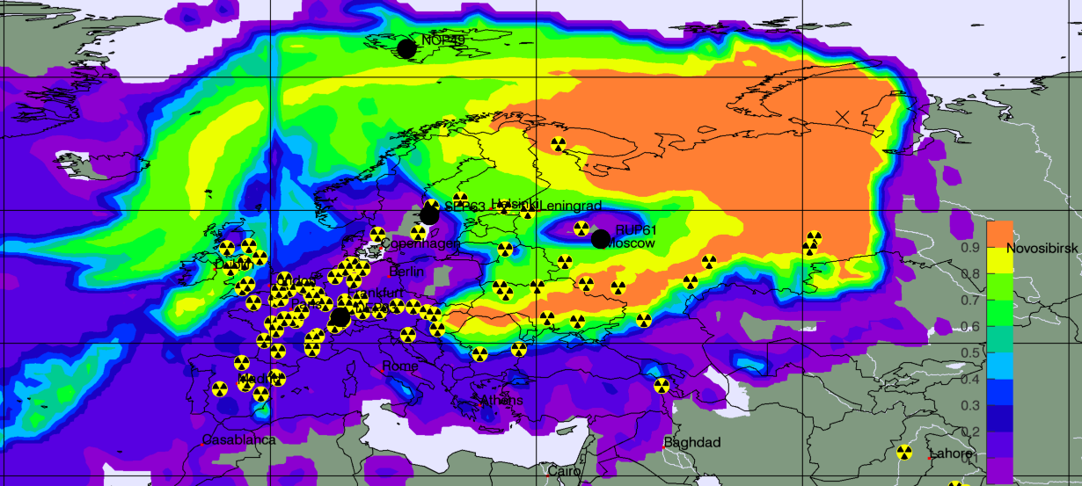
Ru-106 scenario: PSR approach - time-integrated
Field of highest integrated correlations (= Probable Source Region – PSR ) in the time frame Sep., 20th-30th, 2017, largely confined to Russia!
Majak
Dimitrovgrad
Based on FLEXPART-9 and ECMWF 1.0° data; SRS fields from SEP63, DEP33, NOP49 and RUP61 as well as on CTBTO/IDC software WEBGRAPE (Web-connected graphics Engine)

Slide 13
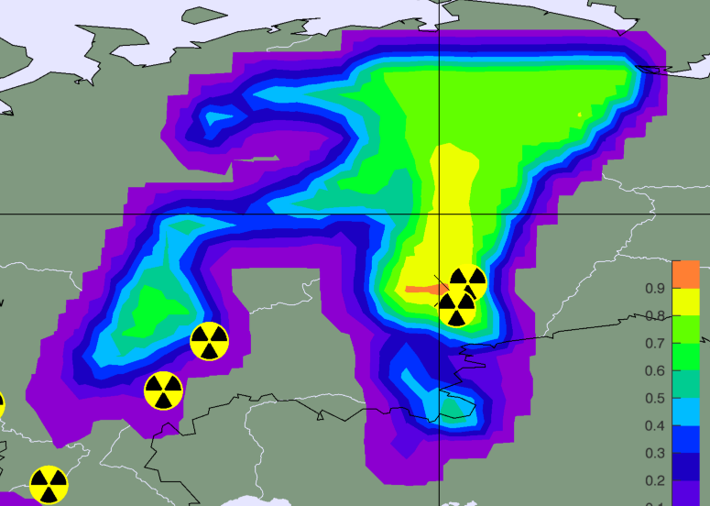
Ru-106 scenario: PSR approach - single time step
Single model for time slot Sep., 25th, 15-18 UTC
Majak
Dimitrovgrad
Based on FLEXPART-9 and ECMWF 1.0° data

Slide 14
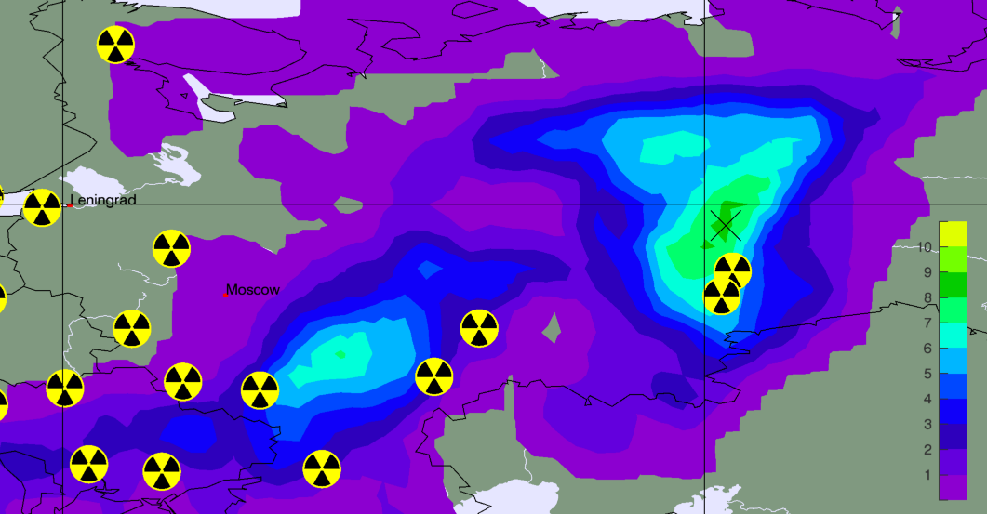
Ru-106 scenario: PSR approach - multi model overlap
Multi-Model overlap for time slot Sep., 25th, 21-00 UTC
Overlap of PSR fields (in total 11) showing at least a correlation of 0.5
Majak
Dimitrovgrad
Based on WMO Regional Specialized Meteorological Centers (RSMC) dispersion model outputs. ZAMG is one of the backtracking RSMCs.

Slide 15
Ru-106 real scenario: Conclusions I
Material was released either around the re-processing plant of Majak (60.8° E Lon. and 55.69 ° N Lat.) or the radiopharmaceutical facility of Dimitrovgrad (49.48° E Lon. and 54.19° N Lat.)
Source strength: ≤1 Petabequerel = 1000 Terabequerel
Most probable release time (according to maximum correlations) between Sep., 25th and 26th
ZAMG‘s results are in agreement with those of the French Institute for Radiation Protection and Nuclear Safety (IRSN) and the German Bundesamt für Strahlenschutz BFS

Slide 16
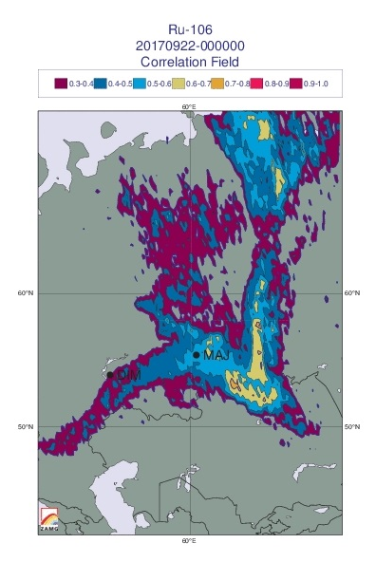
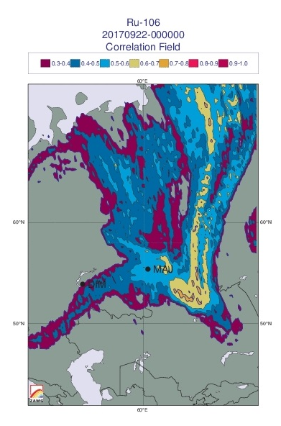
Ru-106 real scenario: Quite some questions remain…
Time-integrated Probable Source Region based on 38 backward fields originating from Romania (observations officially received from the National Environment Protection Agency in Romania)
Majak is not located within the area of maximum correlation!
Even more tricky: if overlap of backward fields in the PRS calculation is enforced
(=hypothesis of one single source location at a single time) PSRs collapse!
Caveats: Model errors (NWP and/or ATM) and wrong measurement metadata can easily be the source of mismatch!
Based on 0-100 m a.g.l. footprints
Based on 0-1000 m a.g.l. footprints

Slide 17
Ru-106 real scenario: Collecting further evidence
ADDITIONAL MATERIAL
Going beyond atmospheric transport modelling

Slide 18
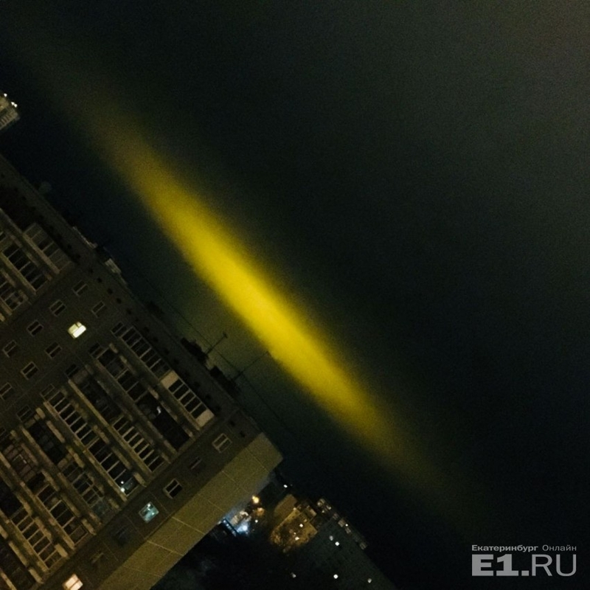
Ru-106 real scenario: Light phenomenon
Austrian pilot report received by ZAMG: “I am a pilot working for a Luxembourgian carrier and was flying back from Novosibirsk to Europe in the night from 25th to 26th of September, local departure time 22:30 (i.e., 17:30 UTC). South of Yekaterinburg we saw a big, slightly greenish, luminous phenomenon in the night sky. The shape of the phenomenon reminded us on a cat’s eye, the color was similar to that one of an aurora borealis. The local aviation authority led the phenomenon back to a probable rocket launch. They had already received some notifications about the phenomenon….During the next half hour the phenomenon disappeared…..”
Artificial light phenomenon observed over Yekaterinburg, night 25th-26th of September 2017 (http://media.englishrussia.com/newpictures/Fishing_in_the_North//104321/102527/2001_50_56_full.jpg)

Slide 19
Ru-106 real scenario: Collecting further evidence
The location of the phenomenon roughly agrees in location with the Majak re-processing plant around 120 km south of Yekaterinburg
The time frame matches very well.
Thus, the following hypotheses possibly explaining the phenomenon were looked at:
1. Magnetic storm
2. (Forest)-fire activity (also in relation to a fire at Majak)
3. Artificial aurora

Slide 20
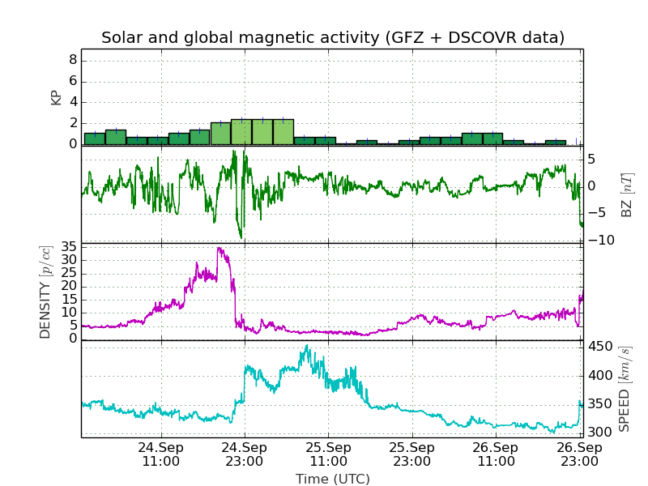
Ru-106 real scenario: Solar and global magnetic activity
In the night when the pilot made his observation the situation was totally calm. It is therefore highly unlikely that this particular observation was caused by solar activity!
Global Geomagnetic Activity Index (KP): 0-3: calm,
4-6: active, 7-9: stormy (from GFZ)
Low activity!
Interplanetary conditions as observed by satellite (DSCOVR)
Measured solar and magnetic activity in the time period 24th to 26th of September 2017.

Slide 21
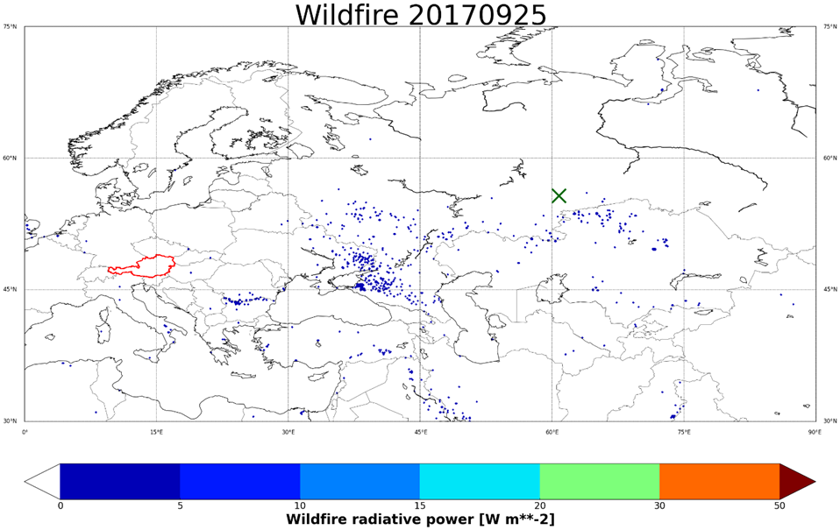
Ru-106 real scenario:Fire radiative power areal density
No fire was detected on Sep., 25th and 26th, at or around Majak!
Average of observed fire radiative power areal density [Watt per meter square] on Sep., 25th, 2017. Blue dots: fires with radiative power areal density below 5 W/m². Green cross: Majak re-processing plant. Data from Copernicus Atmosphere Monitoring Service (CAMS) Global Fire Assimilation System (GFAS)

Slide 22
Ru-106 real case: Artificial aurora due to radioactivity
Artificial auroras have been observed in the past, for example, in the context of atmospheric nuclear tests several decades ago (Glasstone and Dolan, 1977).
Many substances can emit light in the visible range if stimulated by ionizing radiation from radioactive material.
If activities in the 100-1000 TBq range are set free, light releases (artificial auroras) are not unlikely (Steinhauser, personal communication).
As there seems to have occurred no magnetic storm or fire activity, the phenomenon the pilot observed could have indeed been triggered by nuclear activity released at Majak.

Slide 23
Ru-106 real sceario: ZAMG forward simulations
Model: FLEXPART-8.2.3
Meteorological fields: 1.0° ECMWF data with 0.2° nest covering also the Ural
Assumed source location: Majak
Assumed release amount: 10¹⁵ Bq = 1000 TBq
13 consecutive 3-hourly release intervals starting at 20170924 21:00 UTC
Goal: Estimate the most likely release interval and to compare modelled station activity concentrations from all releases with measurements.

Slide 24
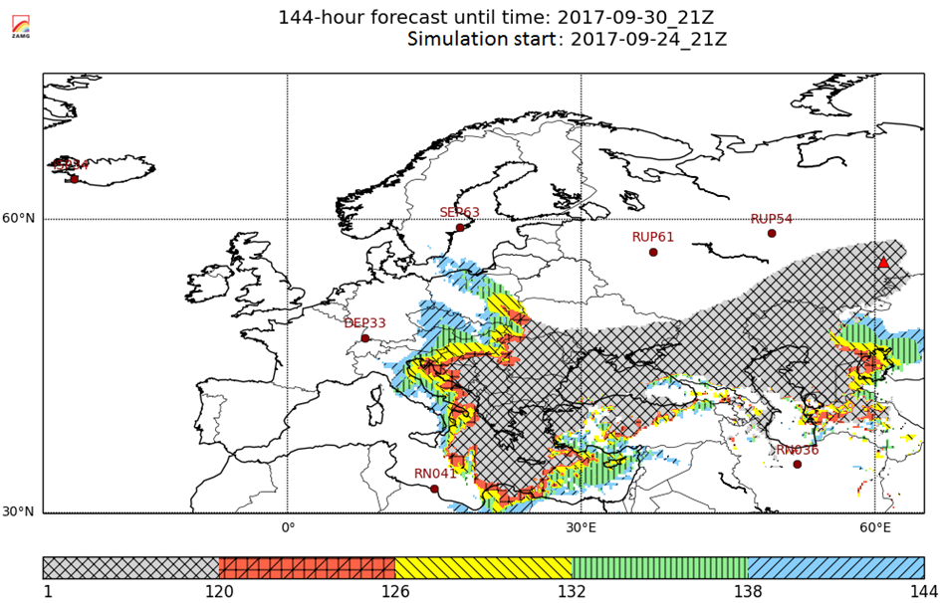
Ru-106 real scenario: Plume arrival times
Arrival times (in hours) relative to simulation start. Red triangle: Majak re-processing plant. Dark red dots: CTBTO IMS stations. Hypothetical plume release at Majak on 25th of September between 18 and 21 UTC

Slide 25
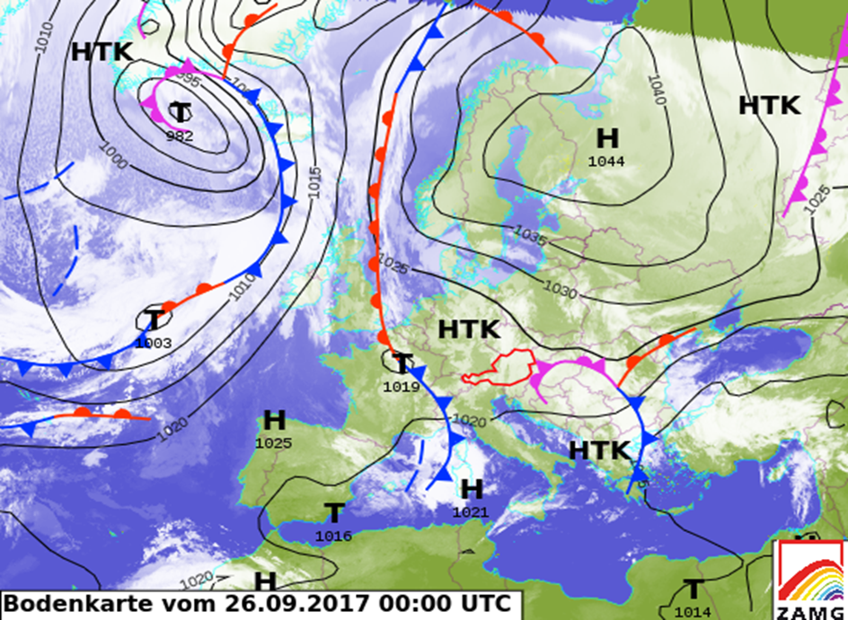
Ru-106 real scenario: General circulation pattern
Anticyclonic transport straight in western and south-western direction by a persisting high pressure system.
ZAMG’s surface pressure chart and front analysis for Sep., 26th, 00:00 UTC.

Slide 26
Ru-106 real scenario: Summary
Observed Ru-106 levels in Europe in early autumn of 2017 were quite unusual. Up to 176 mBq/m³ were measured in Eastern Europe (usually CTBTO uses the unit µBq/m³ for particulates!).
There is high evidence that the source of the Ru-106 is located in Russia (or Kazakshstan) and that a major nuclear accident occurred in a nuclear waste re-processing plant or during transport of material generated there.
A release in the re-processing plant of Majak due to a loss in cooling of a radioactive solution is a likely scenario. Botched fabrication of a Cerium-144 source needed in the search for sterile neutrinos at the Gran Sasso National Laboratory in L'Aquila, Italy, is an option (Cartlidge, 2018).

Slide 27
Ru-106 real scenario: References
THANK YOU FOR YOUR ATTENTION!
References:
S. Glasstone and P. J. Dolan, 1977: The Effects of Nuclear Weapons. 3rd edition, United States Department of Defense and the United States Department of Energy, 653 pp.
Prof. Dr. Georg Steinhauser, 2017. University of Hannover/Institut für Radioökologie und Strahlenschutz, Germany (personal communication; e-mail).
A. Trapeznikov, A. Aarkrog, V. Pozolotina, S. P. Nielsen, G. Polikarpov, I. Molchanova, E. Karavaeva, P. Yushkov, V. Trapeznikova, N. Kulikova, 1994: Radioactive pollution of the Ob river system from Urals nuclear enterprise ‘MAJAK’, Journal of Environmental Radioactivity, 25 (1-2), doi: 10.1016/0265-931X(94)90009-4.
Z. A. Medvedev, 1979: Nuclear disaster in the Urals. Angus and Robertson, London, 240 pp, ISBN 0207 95896 3.
Prof. Dr. Petra Seibert, 2018: Ruthenium-106 event in Europe, Autumn 2017. http://homepage.univie.ac.at/petra.seibert/ru106.html
E. Cartlidge, 2018: Isotope cloud linked to failed neutrino source. Science, 359 (6377), 729, doi: 10.1126/science.359.6377.729.

